Slide 1

Patient Safety Surveillance
and Improvement Program (PSSIP)
A National Overview of Patient Safety Initiatives and
PSSIP Mission/Vision/Goalsetting
August 26, 2021
HEALTHIEST PEOPLE | OPTIMIZE MEDICAID | A GREAT ORGANIZATION

Slide 2


MISSION & VISION
The Utah Department of Health’s mission is to protect the public’s health through preventing avoidable illness, injury, disability, and premature death; assuring access to affordable, quality health care; and promoting healthy lifestyles.
Our vision is for Utah to be a place where all people can enjoy the best health possible, where all can live and thrive in healthy and safe communities.
HEALTHIEST PEOPLE | OPTIMIZE MEDICAID | A GREAT ORGANIZATION
Notes:
This slide should be used to familiarize presentation attendees with the broader role of the Utah Department of Health.

Slide 3
STRATEGIC PRIORITIES
Healthiest People – The people of Utah will be among the healthiest in the country.
Optimize Medicaid – Utah Medicaid will be a respected innovator in employing health care delivery and payment reforms that improve the health of Medicaid members and keep expenditure growth at a sustainable level.
A Great Organization – The UDOH will be recognized as a leader in government and public health for its excellent performance. The organization will continue to grow its ability to attract, retain, and value the best professionals and public servants.
HEALTHIEST PEOPLE | OPTIMIZE MEDICAID | A GREAT ORGANIZATION
Notes:
This slide orients attendees with the specific priorities of the agency. The agency priorities are also carried throughout the presentation on the slide footer.

Slide 4
About the Office of Health Care Statistics
Office of Health Care Statistics oversight includes:
Collect: We collect and produce data that are relevant and useful to our stakeholders
Analyze: We create valuable enhancements to our data resources and our systems have the analytic capacity to transform them into useful information
Disseminate: We make the data and information we collect and produce available to the right people at the right time for the right purposes
HEALTHIEST PEOPLE | OPTIMIZE MEDICAID | A GREAT ORGANIZATION
Notes:
This slide orients attendees with the specific priorities of the agency. The agency priorities are also carried throughout the presentation on the slide footer.

Slide 5
About the Office of Health Care Statistics
Responsible for the following data series:
Healthcare Facilities Data: Includes all institutional “patient encounters” that are provided in the State of Utah by qualifying licensed facilities
Surveys of Customer Satisfaction with Health Plans (CAHPS): Health plans (commercial and Medicaid, medical and dental) conduct annual surveys of their members (Required by statute - implemented by rule)
Self-reported Quality Metrics for Health Plans (HEDIS): Quality of care measures - Healthcare Effectiveness Data and Information Set (HEDIS), which is developed and maintained by the National Committee for Quality Assurance (NCQA).
All Payer Claims Database: Includes claims paid on behalf of Utah residents for the majority of health plans, Medicaid, Medicare Advantage, and third party administrators including PBMs.
Patient Safety Surveillance and Improvement Program (PSSIP): A reporting mechanism which captures patient safety events (injuries, death or other adverse events) associated with healthcare delivery and administration of anesthesia, which fosters conversations on how to minimize adverse patient safety events in Utah.
HEALTHIEST PEOPLE | OPTIMIZE MEDICAID | A GREAT ORGANIZATION
Notes:
This slide orients attendees with the specific priorities of the agency. The agency priorities are also carried throughout the presentation on the slide footer.

Slide 6
Utah Administrative Code
The rules that apply are:
R380-200. Patient Safety Surveillance and Improvement Program (PSSIP).
R380-210. Health Care Facility Patient Safety Program.
R434-150. Adverse Events from the Administration of Sedation or Anesthesia; Recording and Reporting.
HEALTHIEST PEOPLE | OPTIMIZE MEDICAID | A GREAT ORGANIZATION
Notes:
This slide orients attendees with the specific priorities of the agency. The agency priorities are also carried throughout the presentation on the slide footer.

Slide 7
Draft Vision, Mission, and Objectives for Utah’s PSSIP
Vision
Safe patients through collaborative event reporting and patient safety improvement solutions
Mission
Improve patient safety through transparent and nationally-consistent standards for reporting adverse patient safety events, assessment of those events, exploration of best practices and use of quantitative and qualitative data to educate and promote statewide patient safety improvement solutions.
Objectives
Public accountability and transparency through event reporting
Adherence to national standards of event-reporting
Healthcare facilities have processes in place to identify and report all reportable adverse events
Agreement on which patient safety events should be reported
Educated stakeholders and statewide patient safety improvement solutions based on quantitative and qualitative data from event reporting
Quarterly meetings with all healthcare systems represented
HEALTHIEST PEOPLE | OPTIMIZE MEDICAID | A GREAT ORGANIZATION

Slide 8
State by State Patient Safety Initiatives
An Overview of Patient Safety Initiatives Outside of Utah
HEALTHIEST PEOPLE | OPTIMIZE MEDICAID | A GREAT ORGANIZATION

Slide 9
State by State Patient Safety Initiatives
Purpose of this presentation
To learn about the adverse event reporting systems of other states
  And show why state-by-state comparisons are difficult
To learn about other tools available to measure adverse event reporting system efficacy
Learning Objectives
See how other states reporting systems compare to Utah’s
Understand the national landscape of how patient safety is managed
Compare and contrast different tools of comparison for patient safety reporting
HEALTHIEST PEOPLE | OPTIMIZE MEDICAID | A GREAT ORGANIZATION

Slide 10
State by State Patient Safety Initiatives
Current Available Tools
National Academy For State Health Policy (NASHP)
2014 Guide to State Adverse Event Reporting Systems
  Surveyed all 50 states + DC with a focus on adverse event reporting systems
Interactive Patient Safety Map and Toolkit (last updated 2009)
Agency for Healthcare Research and Quality (AHRQ)
Patient Safety Indicators (PSIs) – Use administrative data from hospitalization discharge records to identify potential in-hospital complications
Institute for Healthcare Improvement (IHI)
Global Trigger Tool – Review of medical records looking for certain occurrences or prompts that might trigger investigation to see if an adverse event occurred
HEALTHIEST PEOPLE | OPTIMIZE MEDICAID | A GREAT ORGANIZATION

Slide 11
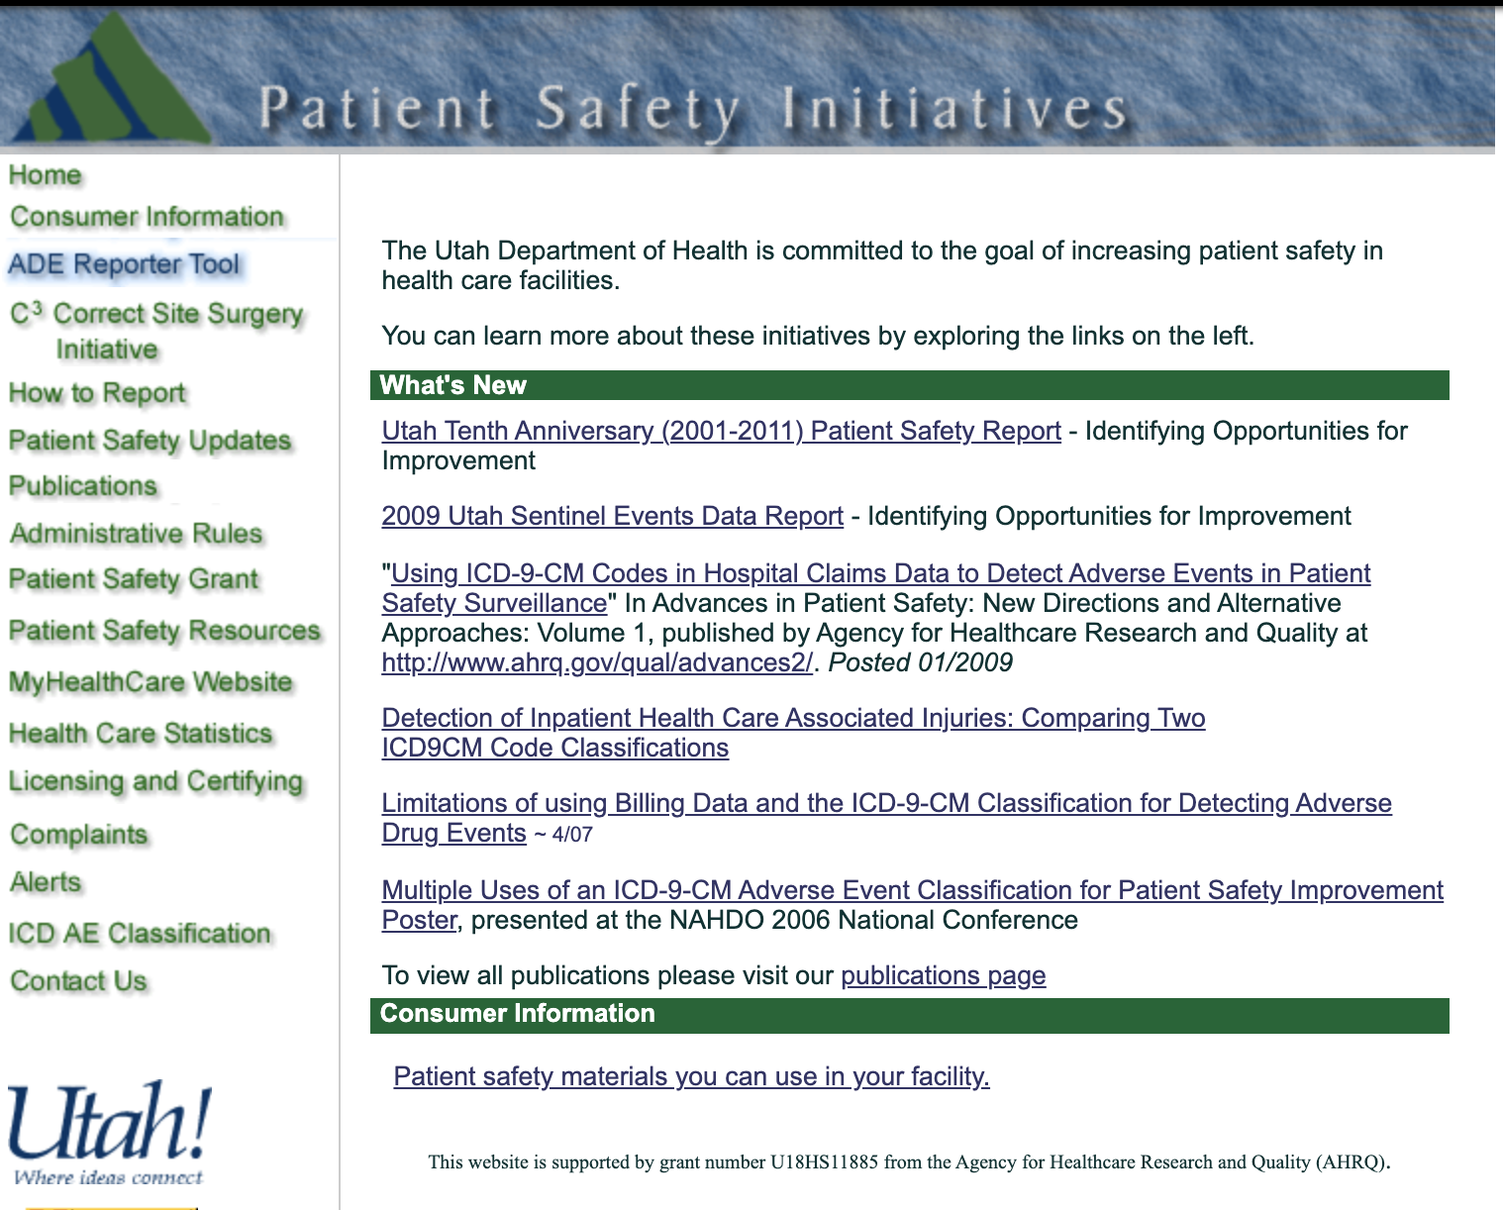
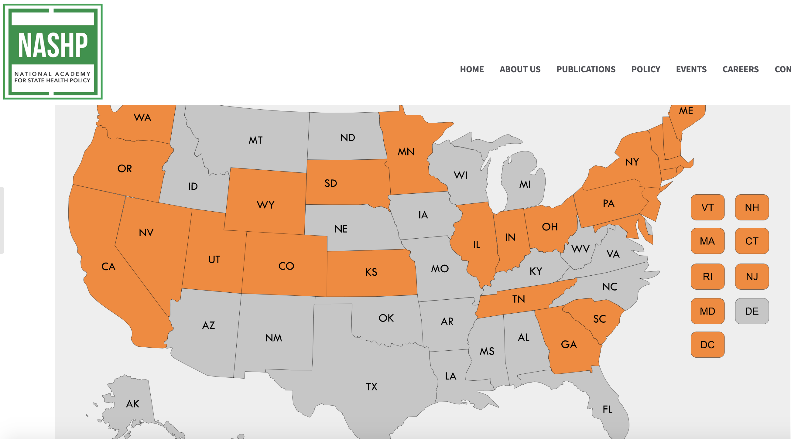
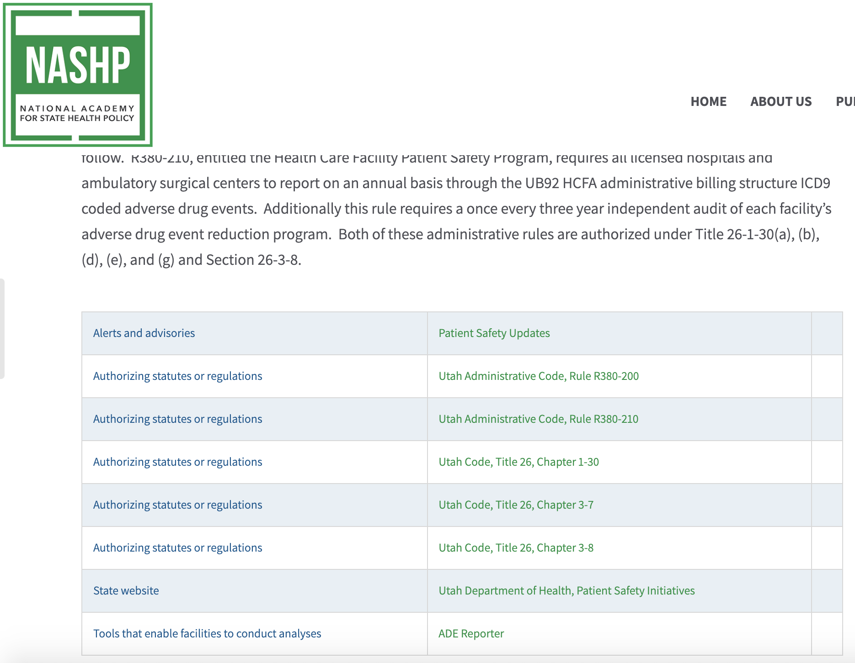
State by State Patient Safety Initiatives
NASHP Interactive Map and Toolkit
Utah’s link for ‘State website’ ->
https://www.nashp.org/patient-safety-toolkit/
After clicking on Utah ->
Many of this tool’s links are out-of-date
HEALTHIEST PEOPLE | OPTIMIZE MEDICAID | A GREAT ORGANIZATION

Slide 12
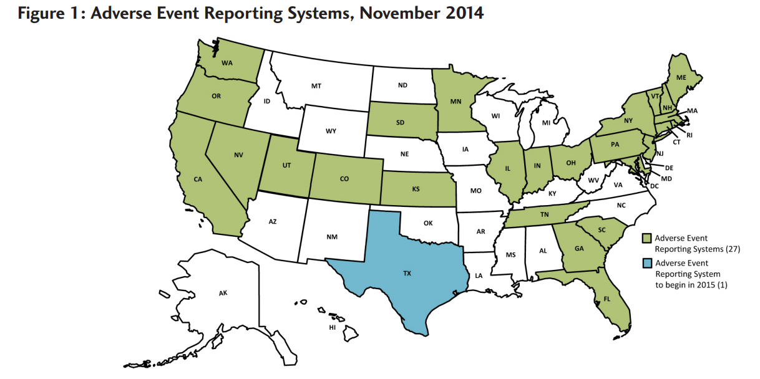
States with Adverse Event Reporting Systems
From National Academy for State Health Policy’s (NASHP) 2014 report on adverse event reporting systems
Gathered from a survey administered by NASHP
27 states with adverse event reporting systems - also the District of Columbia
Image: Hanlon et al., 2015
HEALTHIEST PEOPLE | OPTIMIZE MEDICAID | A GREAT ORGANIZATION

Slide 13
States with Adverse Event Reporting Systems
What is different today?
Based on research on all 50 states, these were the changes we saw since 2014
- No evidence of program
- Program started
Programs started since 2014:
HI (only for patients w/ developmental disabilities)
LA
TX
VA
Programs existing in 2014 with no online presence today:
GA
SD
Note – states were NOT contacted – changes were based on our own research and may be inaccurate
Image: Hanlon et al., 2015
HEALTHIEST PEOPLE | OPTIMIZE MEDICAID | A GREAT ORGANIZATION

Slide 14
States with Adverse Event Reporting Systems
States with adverse patient safety event reporting systems in 2021:
CA IN MN OR UT
CO KS NV PA VT
CT LA NH RI VA
FL ME NJ SC WA
HI MD NY TN
IL MA OH TX
States with proposed adverse event reporting laws or mandatory reporting laws to Patient Safety Organizations (PSOs):
MI MO NE NC WV
Unable to find adverse event reporting systems based on our research:
AL DE KY ND WY
AK GA MS OK
AZ ID MT SD
AR IA NM WI
Again, note that GA and SD have had reporting systems in the past and may still have them, but our research found no evidence of current reporting systems for those states
HEALTHIEST PEOPLE | OPTIMIZE MEDICAID | A GREAT ORGANIZATION

Slide 15
Enforcement of Reporting By State
Mandatory reporting, with specified penalties
CA ($100 per day) MA ($1,000 per week) UT (up to $5,000)
MD ($500 per day) PA* ($1,000 per day)
Mandatory, no penalty reporting
IN NJ WA
Mandatory, non-specified penalty reporting
CO MN RI
CT NV SC
FL NH VT
IL NY
Voluntary reporting
OR*
Unspecified
HI KS LA ME OH TN TX VA
* These states require hospitals to pay a fee for participation in their programs
HEALTHIEST PEOPLE | OPTIMIZE MEDICAID | A GREAT ORGANIZATION

Slide 16
Facilities Required to Report by State
‘Other’ includes obstetric centers, diagnostic centers, pharmacies, and rehabilitation facilities
The 2 types of facilities UT requires to report: hospitals and ambulatory surgical centers
Data was compiled through a review of each state’s reporting rule or law
HEALTHIEST PEOPLE | OPTIMIZE MEDICAID | A GREAT ORGANIZATION

Slide 17
Facilities Required to Report by State
Only for states that require more than 2 types of facilities to report
The 2 types of facilities UT requires to report: hospitals and ambulatory surgical centers
CO and KS require any licensed facility to report. LA and MD don’t specify which facilities are required to report.
HEALTHIEST PEOPLE | OPTIMIZE MEDICAID | A GREAT ORGANIZATION

Slide 18
Definition of adverse Events by state
National Quality Forum’s (NQF) list of Serious Reportable Events:
CA NV WA
IL NH
ME UT
MA VT
Modified version of NQF’s list:
CT NJ
IN NY
MN TX
State-specific list:
CO OH SC
FL RI TN
State-specific definition:
HI MD VA
KS OR
LA PA
HEALTHIEST PEOPLE | OPTIMIZE MEDICAID | A GREAT ORGANIZATION

Slide 19
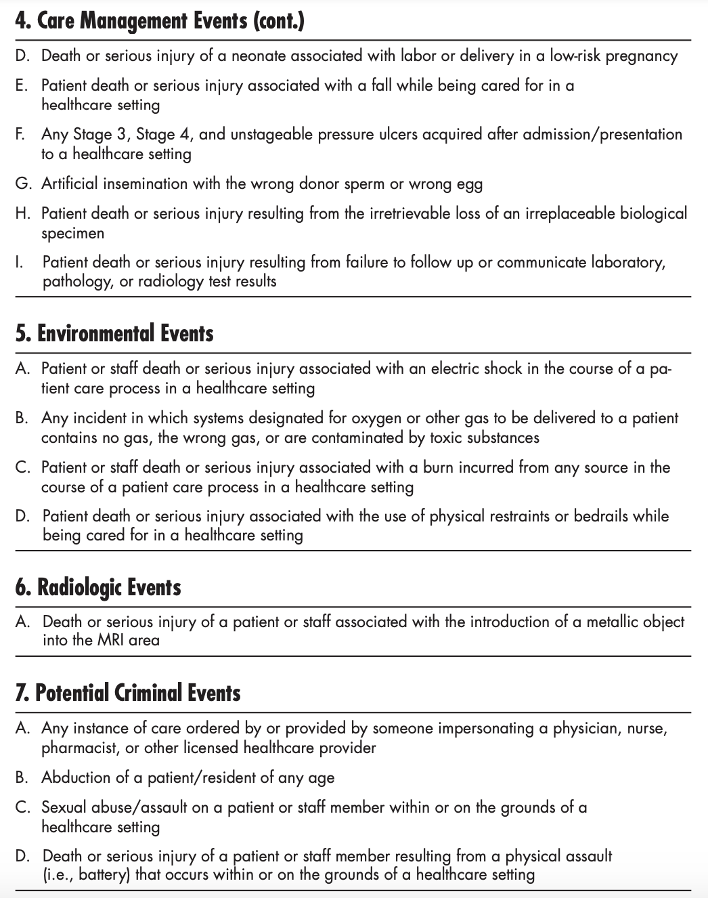
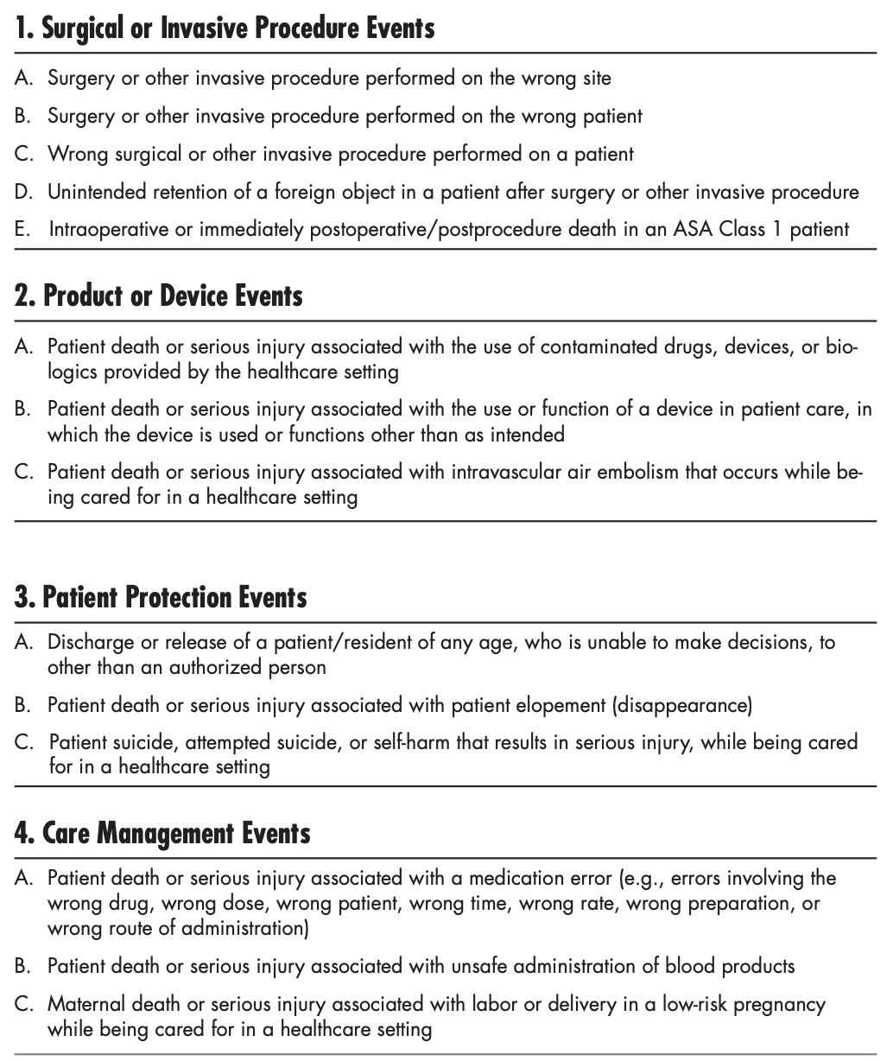
Definition of adverse Events by state
NQF’s list of Serious Reportable Events
Source: Patient Safety Indicators Overview - https://www.qualityindicators.ahrq.gov/Modules/psi_resources.aspx#techspecs
HEALTHIEST PEOPLE | OPTIMIZE MEDICAID | A GREAT ORGANIZATION
Notes:
Add source

Slide 20
When reporting program rules or laws were enacted
Only for states where the date is publicly available
X denotes the start of a reporting program
Utah’s patient safety reporting program started in 2001
HEALTHIEST PEOPLE | OPTIMIZE MEDICAID | A GREAT ORGANIZATION

Slide 21
challenges with state by state comparisons
What we have hopefully shown:
Adverse patient safety event reporting programs are NOT uniform across US states
Differences arise in:
  Enforcement of reporting
  Types of facilities that report
  Definitions of adverse events
  Whether a state even has a reporting system or not
  Many other areas that we haven’t shown, such as: program funding, methods of reporting, agencies responsible for reporting, and with whom reporting data is shared
HEALTHIEST PEOPLE | OPTIMIZE MEDICAID | A GREAT ORGANIZATION

Slide 22
An Alternative
Instead of comparing event reporting numbers to other states to see how safe our state is or how comprehensive our reporting is, we can use indicator/trigger tools to answer those same questions
Traditional Reporting | AHRQ’s Patient Safety Indicators | IHI’s Global Trigger Tools
Advantages Inexpensive Easy to obtain information Limitations Only captured 1% of all harmful events in 2011 Classen study Focus on error, not harm Staff often perceives reporting as negative (punitive) Time-insensitive | Advantages Standard definitions Allows direct comparison between hospitals Inexpensive to obtain data Limitations Poor sensitivity and specificity Focus is only on certain harm types, not “all cause” harm Dependent on accuracy and descriptiveness of charting Only captured 9% of all harmful events in 2011 Classen study | Advantages Measures “all cause” harm Provides a rate (per 100 admissions) Excellent specificity and very good sensitivity Captured 90% of all harmful events in 2011 Classen study Limitations Requires training Resource intensive Not automated
Sources: Sharek, 2012 - PMID: 23667349, Classen et al., 2011 - https://doi.org/10.1377/hlthaff.2011.0190
HEALTHIEST PEOPLE | OPTIMIZE MEDICAID | A GREAT ORGANIZATION

Slide 23
References
Classen, D. C., Resar, R., Griffin, F., Federico, F., Frankel, T., Kimmel, N., Whittington, J. C., Frankel, A., Seger, A., & James, B. C. (2011). ‘Global trigger Tool’ shows that adverse events in hospitals may be ten times greater than previously measured. Health Affairs, 30(4), 581–589. https://doi.org/10.1377/hlthaff.2011.0190
Griffin, F.A., Resar, R.K. IHI Global Trigger Tool for Measuring Adverse Events (Second Edition). IHI Innovation Series white paper. Cambridge, Massachusetts: Institute for Healthcare Improvement; 2009.
Hanlon, C., Sheedy, K., Kniffin, T., Rosnthal, J. (2015) 2014 Guide to State Adverse Event Reporting Systems. National Academy for State Health Policy.
Patient safety indicators overview. Patient Safety Indicators (PSI) Overview. (n.d.). https://www.qualityindicators.ahrq.gov/Modules/psi_resources.aspx#techspecs.
Patient safety map & toolkit. The National Academy for State Health Policy. (n.d.). https://www.nashp.org/patient-safety-toolkit/.
Sharek, P. J. (2012) The Emergence of the Trigger Tool as the Premier Measurement Strategy for Patient Safety. AHRQ M&M, 120(5). PMID: 23667349

